Slide 1
Lesson 2: Using Copilot for Outlook and Teams

Slide 2

Meet Your Presenter
Khalaf Haddad
Principal, Imua Learning
Over three decades of Technical Training, Leadership and Professional Development Experience
Published Author
Interests: History, General Aviation, Distance Running
Fun Fact: Khalaf and his wife are enjoying their first grandchild born in April 2024!

Slide 3
Pearson’s Copilot Training
Connecting the dots across Pearson’s AI Strategy

Slide 4
Phase 2 – Application Training
Lesson 1: Writing Prompts for Copilot
Lesson 2: Copilot for Outlook and Teams
Lesson 3: Copilot for Word and Excel
Lesson 4: Copilot for PowerPoint and Edge
Discover the art of creating effective prompts for Copilot.
Learn to work with Copilot’s capabilities in Outlook and Teams.
Learn to work with Copilot’s capabilities in Word and Excel.
Learn to work with Copilot’s capabilities in PowerPoint and the browser.

Slide 5

Badges

Slide 6
Outline
1
Review of Prompt Writing
2
Copilot in Outlook
3
Copilot in Teams
4
Practice Exercises

Slide 7
Review of Prompt Writing
Notes:
Lesson objectives and audience, Introducing Copilot and its role, Importance of prompt engineering

Slide 8

What is Prompt Writing?
Copilot: Your personal AI assistant!
Prompt: The instructions given to Copilot to perform a task.
Notes:
"Think of Copilot as a highly capable assistant. Just like with a human assistant, the clearer your instructions, the better the outcome.“ Effective prompts are the key to unlocking Copilot's full potential, leading to more accurate, relevant, and useful outputs. Briefly mention the concept of "Garbage In, Garbage Out" (GIGO) in the context of AI prompts.

Slide 9
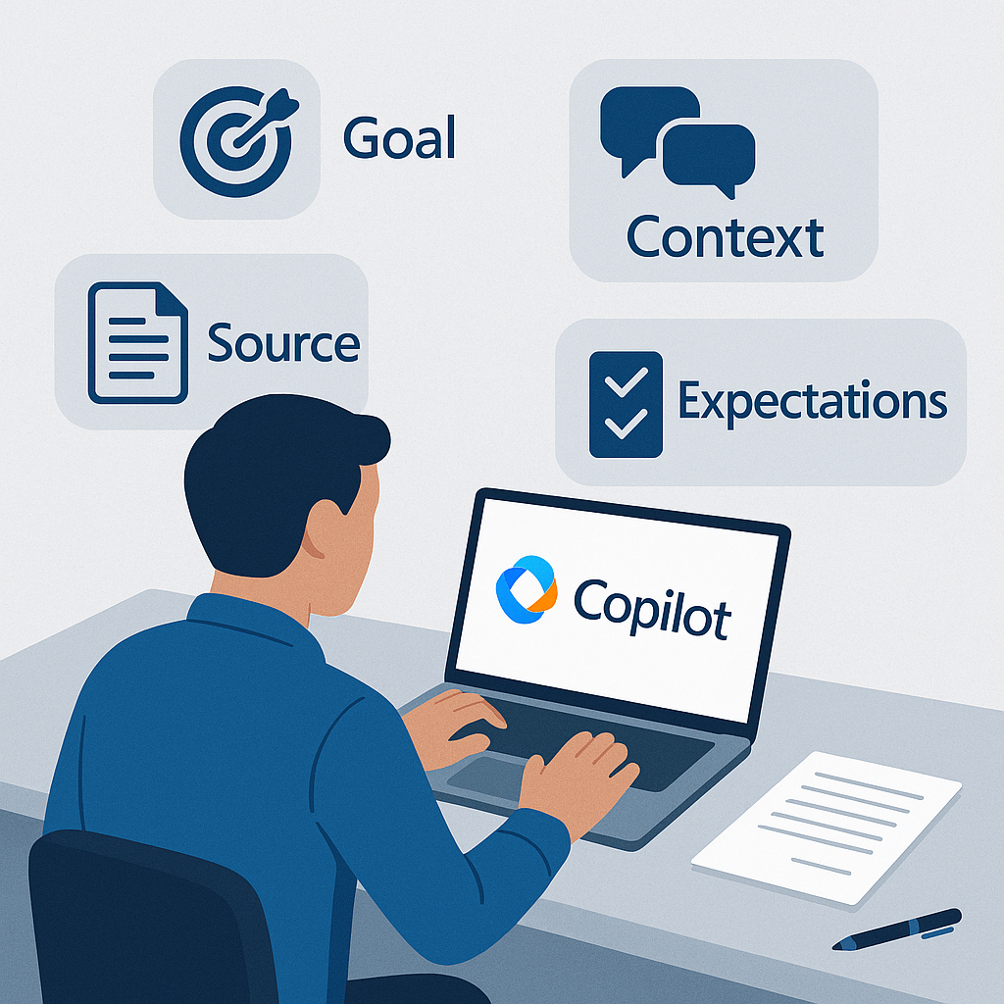
Core Elements of an Effective Prompt
Goal
Context
Expectations
Source
Notes:
Goal
What it is: This is the primary task you want the AI to accomplish. It defines the core action or purpose of your request.
Why it's important: It tells the AI exactly what you want to achieve. A clear goal prevents the AI from providing a general or irrelevant response.
Example: "Write a press release." (This is a clear goal.)
Context
What it is: This is the background information and reasoning behind your request. It helps the AI understand the purpose and significance of the task.
Why it's important: Context allows the AI to make more informed decisions about the content, tone, and focus of its output. It tells the AI "why" you are asking for something.
Example: "The press release is to announce our company's new partnership with a non-profit organization focused on environmental sustainability. This is a major corporate social responsibility initiative."
Expectation
What it is: This defines the specific requirements for the final output. It covers the format, tone, length, and any other structural or stylistic details.
Why it's important: It ensures the AI's response meets your exact needs, minimizing the need for extensive edits and revisions. It tells the AI "how" you want the response to look and feel.
Example: "The press release should be professional and inspiring. It must be no more than 400 words and should include a quote from our CEO and a quote from the non-profit's director. It should be formatted with a clear headline and subheadings.“
Source
What it is: This is the specific data or documents the AI should reference to inform its response. This is particularly useful in Copilot, which can ground its responses in your company's data.
Why it's important: Providing a source ensures the AI's response is accurate, factually correct, and consistent with your specific information. It prevents the AI from making up information or using generic data.
Example: "Please use the key details from the 'Partnership Agreement Q2 2025' document to get the correct names, dates, and mission statements."

Slide 10

Best Practices for Writing Prompts
Be specific and clear.
Lead with positive instructions.
Break down complex tasks.
Specify a persona.
Provide examples.
Iterate and refine.
Review and verify.
Notes:
Writing an effective prompt is the key to getting the best possible results from an AI like Microsoft Copilot. A well-crafted prompt gives the AI clear instructions, context, and constraints, ensuring a relevant and high-quality response.
Here are the best practices for writing prompts, combining a core framework with additional tips for success.
1. Use the "G-C-E-S" Framework
This is the foundational model for every great prompt. Ensure you include these four elements whenever possible.
Goal: State the primary task you want the AI to accomplish. (e.g., "Write a blog post...")
Context: Provide the background information. (...for an internal company newsletter about our new work policy.")
Expectation: Define the format, tone, and specific requirements for the output. (...The tone should be encouraging and professional, no more than 500 words, and structured with an intro, three main points, and a conclusion.")
Source: Direct the AI to a specific document or data set to reference. ("...Please use the attached PDF 'Hybrid Work Policy 2024' as a source.")
2. Be Specific and Detailed
Vague prompts lead to vague answers. The more specific you are, the better the AI can tailor its response. Avoid open-ended requests that lack clear direction.
Instead of: "Write about customer service."
Try: "Write a 300-word article on how to handle difficult customer service calls, focusing on active listening and de-escalation techniques. The audience is new call center employees."
3. Use Positive Instructions
Tell the AI what "to do" rather than what "not to do." This is more effective as it gives the AI a clear path to follow.
Instead of: "Do not mention our competitors in the press release."
Try: "Focus the press release exclusively on our product's unique features."
4. Break Down Complex Tasks
For multi-step or highly complex requests, it's often more effective to use a series of prompts. Start with a broad request and then refine the output with follow-up prompts.
Step 1: "Generate an outline for a sales training manual on objection handling."
Step 2: "Expand the section on 'common objections' and provide three example scripts for each."
Step 3: "Rewrite the introduction to be more inspiring and motivational."
5. Specify a Persona or Role
Assigning a persona to the AI helps it adopt the appropriate voice and perspective for the task.
Instead of: "Explain a new marketing strategy."
Try: "Act as a senior marketing director and explain the new product launch strategy to a team of junior managers."
6. Provide Examples
If you have a specific style or format in mind, include an example in your prompt. This gives the AI a template to follow.
Prompt: "Write a product description for our new laptop. Here is an example of the style I like: 'The new Stellar-X drone is sleek, powerful, and ready for adventure. Capture stunning aerial footage with its 4K camera and fly for up to 30 minutes on a single charge.'"
7. Iterate and Refine
The first response may not be perfect. Use a conversational approach to refine the output. Think of it as a collaboration.
"This is a good start, but can you make the tone more formal?"
"Expand on the second bullet point and provide more detail."
"Please shorten this paragraph to two sentences."

Slide 11
Copilot in Outlook
Notes:
Copilot enriches Outlook by providing smart email drafting, inbox management, and meeting scheduling features that simplify daily communication and organization.

Slide 12

Intelligent Email Drafting and Replies
AI-Generated Drafts
Suggested Replies
Time Efficiency
Notes:
AI-Generated Drafts
Copilot creates email drafts using AI, enabling faster email composition without sacrificing quality.
Suggested Replies
AI suggests professional and clear email replies, helping users respond efficiently.
Time Efficiency
Using AI assistance saves time in composing emails while ensuring clarity and professionalism.

Slide 13

Inbox Management and Prioritization
Email Prioritization
Urgent Message Flagging
Inbox Organization
Notes:
Email Prioritization
Copilot automatically identifies and highlights important emails for immediate attention.
Urgent Message Flagging
Urgent messages are flagged to ensure prompt response and better time management.
Inbox Organization
The inbox is organized to reduce clutter and improve user focus on key tasks.

Slide 14

Meeting Scheduling and Follow-Ups
Automated Meeting Time Suggestions
Managing Calendar Invites
Drafting Follow-Up Emails
Notes:
Automated Meeting Time Suggestions
Systems can automatically propose optimal meeting times based on participants' availability, improving scheduling efficiency.
Managing Calendar Invites
Calendar invitations are managed seamlessly to ensure all attendees receive and confirm meeting requests promptly.
Drafting Follow-Up Emails
Automated drafting of follow-up emails helps maintain communication and action items after meetings conclude.

Slide 15
Copilot in Teams
Notes:
Within Teams, Copilot enhances collaboration through real-time assistance during meetings, chat automation, and workflow improvements.

Slide 16
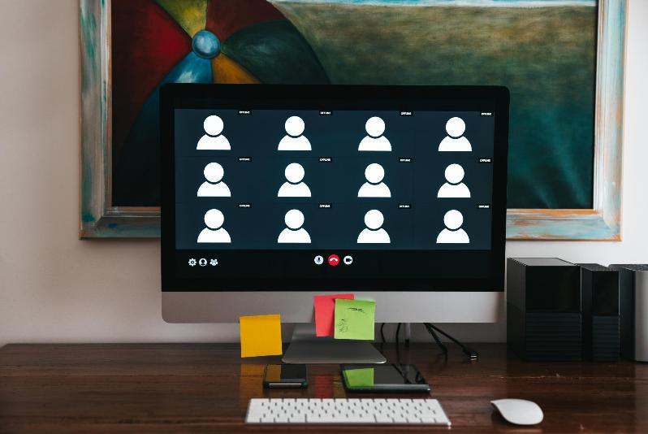
Real-Time Meeting Summaries and Action Items
Instant Meeting Summaries
Action Item Identification
Team Alignment
Notes:
Instant Meeting Summaries
Copilot automatically creates concise summaries during meetings, saving time and effort.
Action Item Identification
The tool highlights key action items, ensuring accountability and clear next steps.
Team Alignment
Real-time insights keep teams aligned and reduce the need for manual note-taking.

Slide 17

Automated Chat Assistance
Automated Response Generation
Enhanced Team Communication
Notes:
Automated Response Generation
Automated chat tools generate instant responses, speeding up communication processes within teams.
Enhanced Team Communication
Facilitates clearer and faster communication among team members by providing relevant suggestions in chats.

Slide 18
Collaboration Workflow Enhancements
Task Assignments Integration
File Sharing Features
Reminders and Notifications
Notes:
Task Assignments Integration
Copilot simplifies assigning and tracking tasks directly within team channels and chats for better organization.
File Sharing Features
Seamless file sharing is integrated into conversations, enabling quick access and collaboration on documents.
Reminders and Notifications
Automated reminders help keep the team on track by notifying members about upcoming deadlines and tasks.

Slide 19
Next Steps and Action Items
Where do we go from here?

Slide 20
Section title
Next Steps and Action Items
Be sure to:
Use Copilot Chat and write more prompts
Complete survey
Monitor the Copilot SharePoint Site
Copyright 2025 Pearson. All rights reserved.
Notes:
Use script and share links

Slide 21
Thank You!

